Slide 1
EEEE2076 – Software Development Project
Introduction to Module

Slide 2
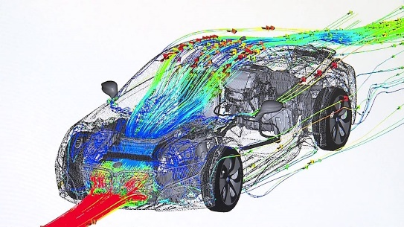
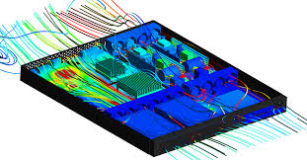
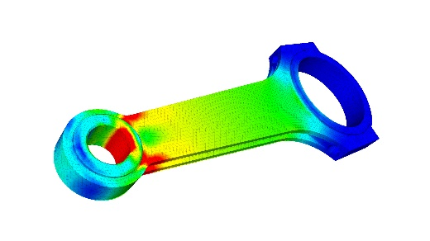
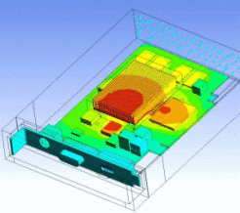
Background: CAD & Modelling Tools
Most products / systems are designed on computers
3D Computer Aided Design (CAD) tools allow visualisation and editing of designs.
These 3D models are then passed to computer simulation programs to predict how they will perform:
Temperatures
Stresses
Air flows
The results of these simulations are then overlaid onto the 3D model for analysis
We’ll just deal with CAD part for this project – getting the nice graphical waveforms involves solving partial differential equations:
You will cover (most of) the maths for this with Neo in the 2055 module.
I will also show an example in lectures for this module – video of this being done in real-time with augmented reallity

Slide 3
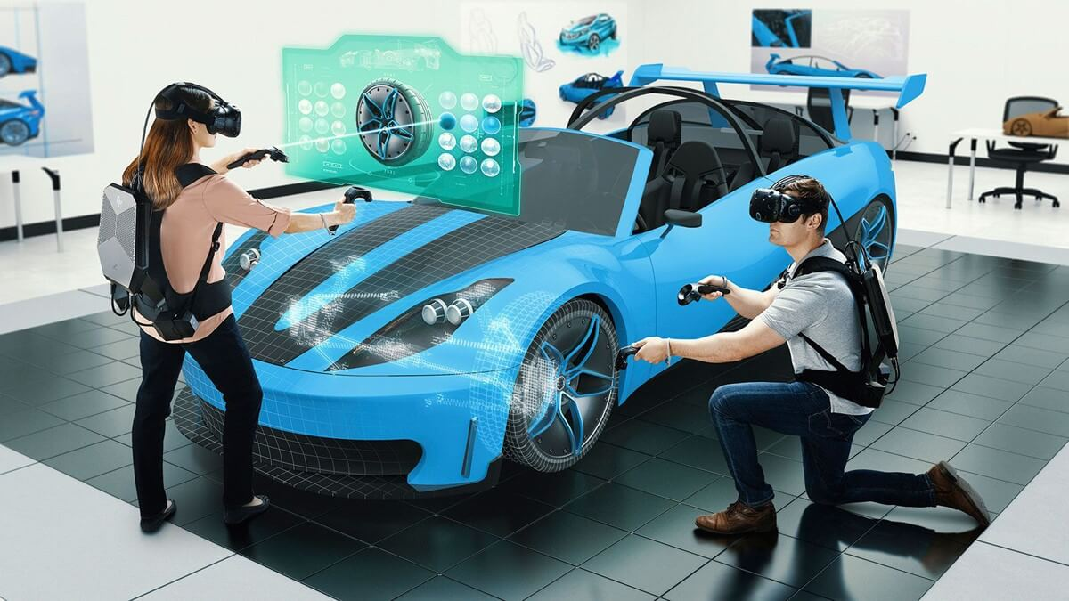
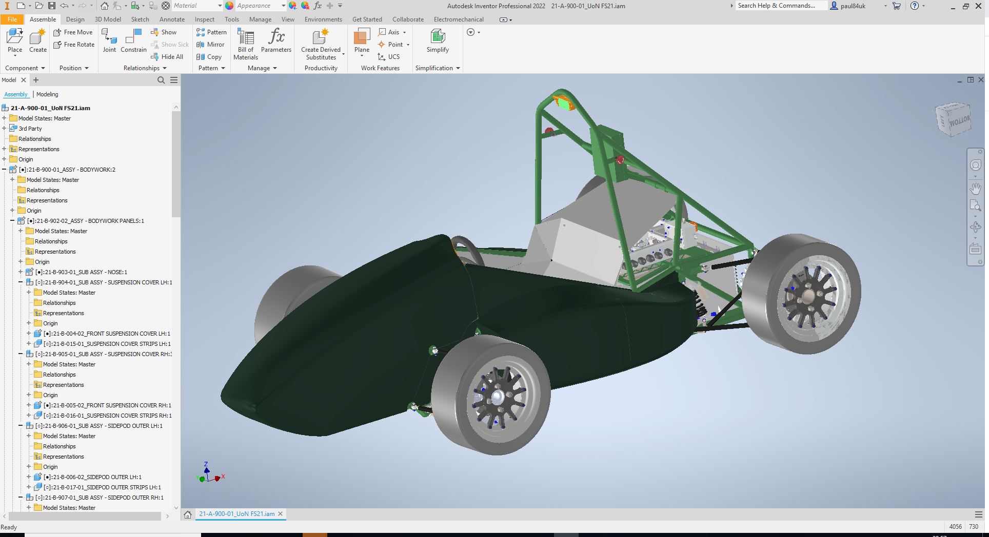
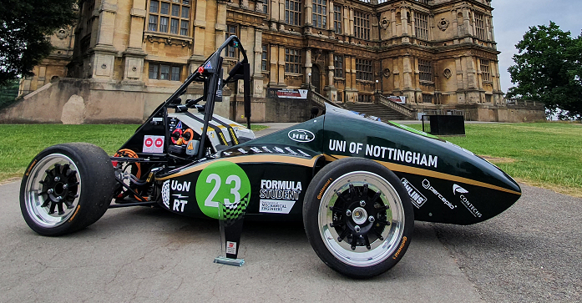
Background: Virtual and Augmented Reality
Lots of interest in using Virtual and Augmented Reality systems to make CAD and 3D simulations more interactive
Aim of project is to understand how these systems work … by developing your own
Write a software application, in C++, that can render a CAD model of our 2021 Formula Student car in Virtual Reality
Extended objectives for user interface design and VR effects

Slide 4
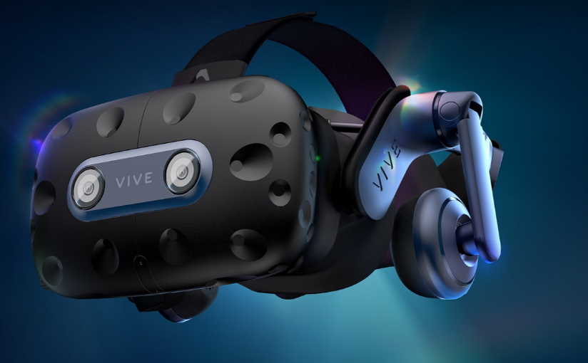
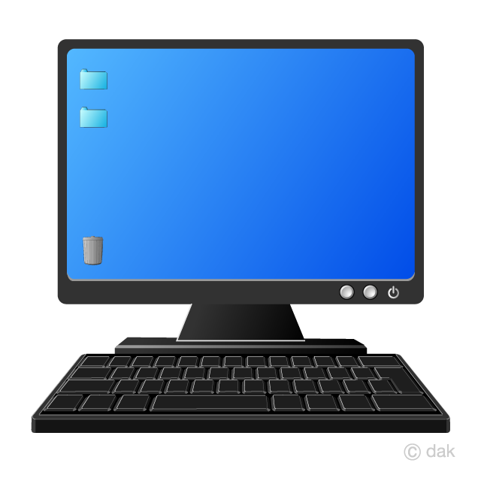

System Overview
VR System – HTC Vive Pro 2
VR Control Software – C++,Qt, VTK
Menus to select CAD files & Options
Render to VR Headset or to Window for testing
CAD Files – Formula Student car assemblies

Slide 5
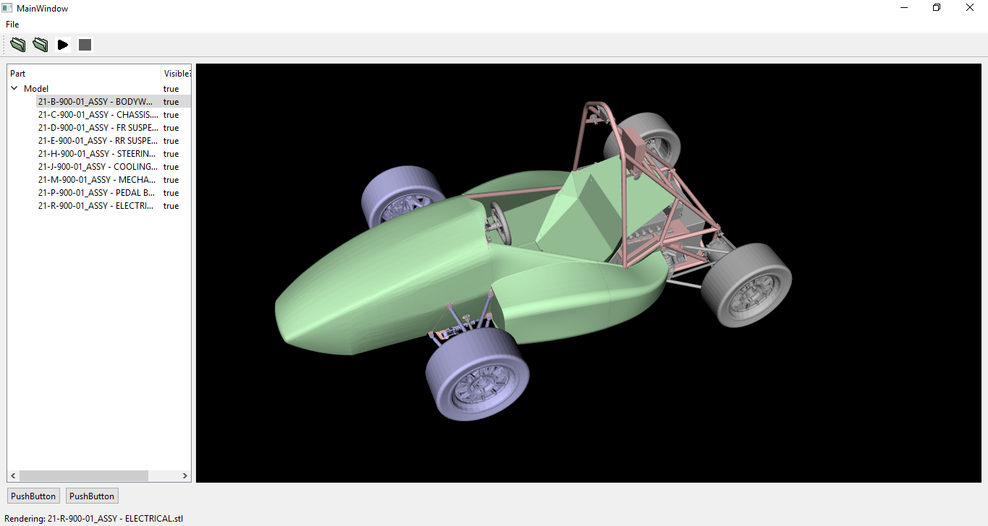
The Final Application

Slide 6
Primary Objectives
2
1
O1: PC based, base station application.
Load, view, manipulate CAD files
O2: Add VR output to base station.
Create an interactive VR experience

Slide 7
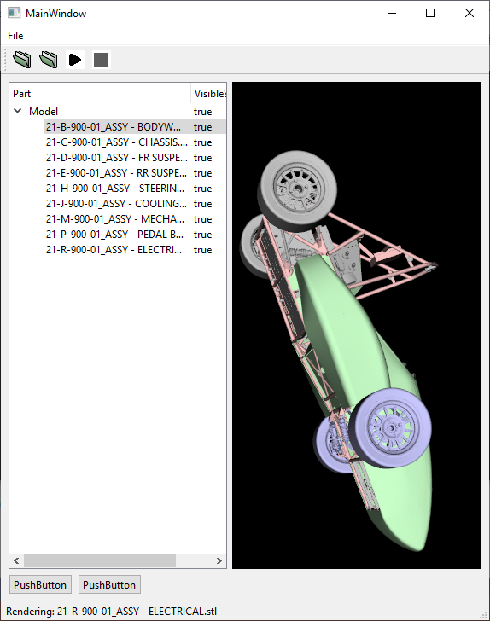
O1: VR Base-station GUI
Code that compiles and runs without errors
A team Github repository to host the code
A functional GUI (with limited features, not completely finished)
The ability to load CAD models of assemblies and store in a “treeview”
Menus that allow basic properties (name, colour, visibility) to be edited for components
A working 3D viewer within the GUI to visualise the model that is loaded

Slide 8
O2: VR Enabled Base-station
Your finished, professional looking GUI is used to load model and start VR
Ability to render to VR system
Specific 3D/VR features implemented (see later lectures / pdf on Moodle)
Working installer
Code documentation, including reference website

Slide 9
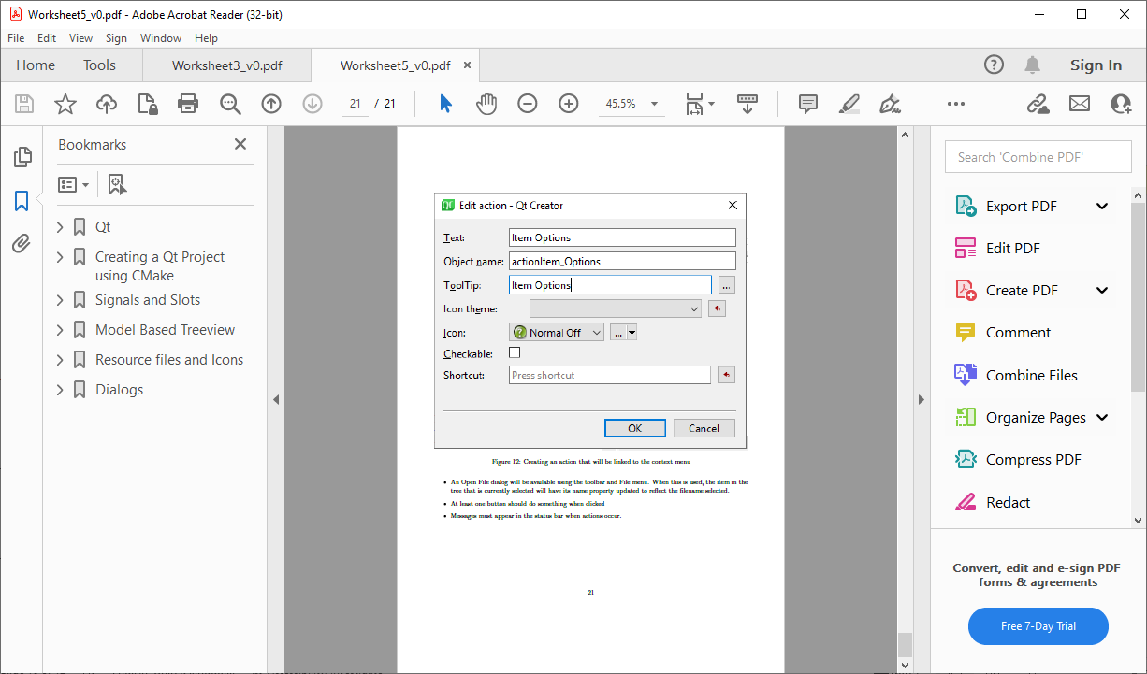
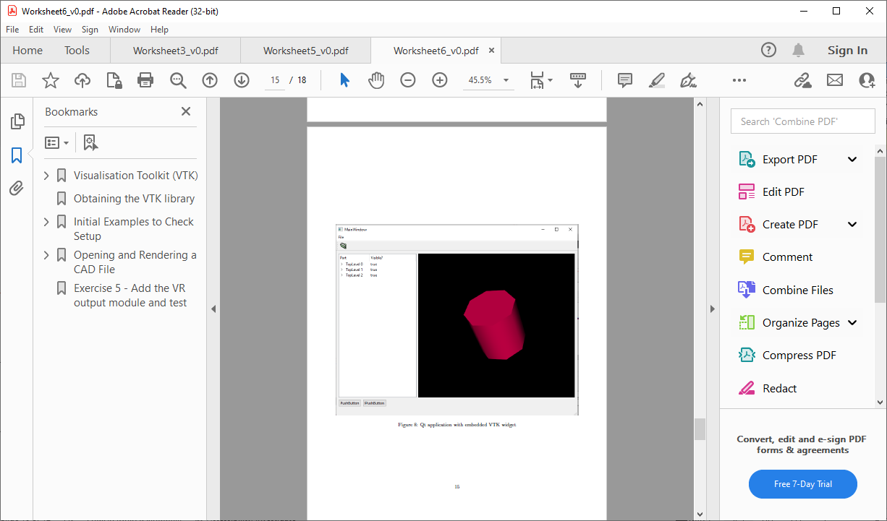
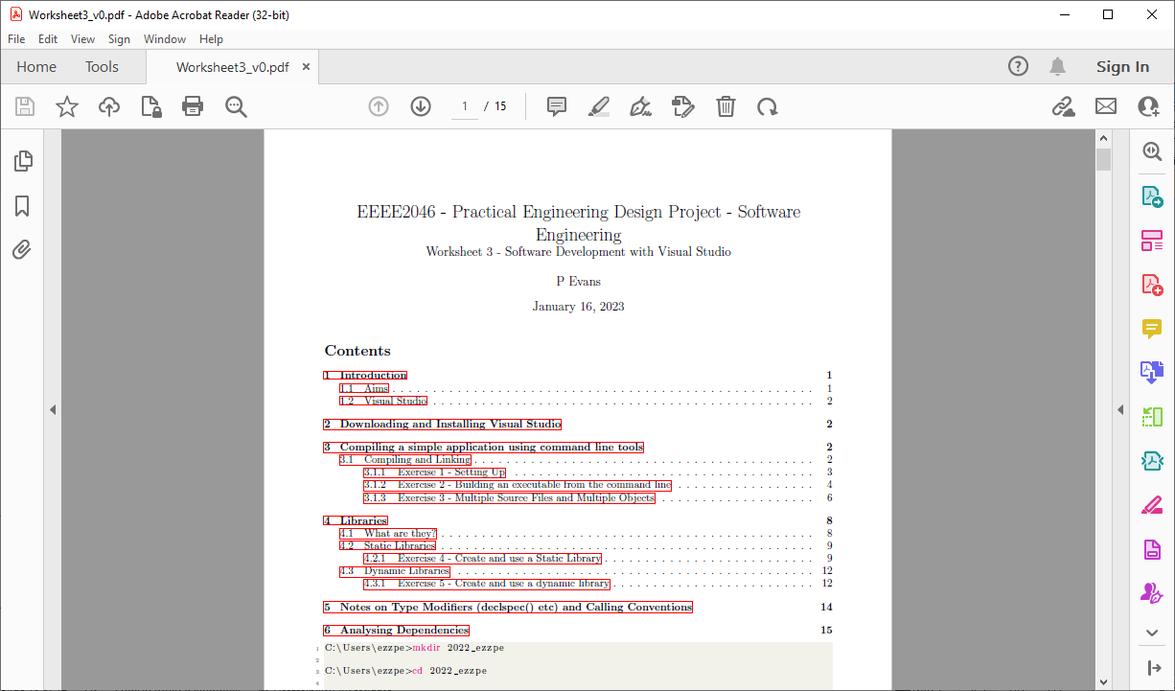
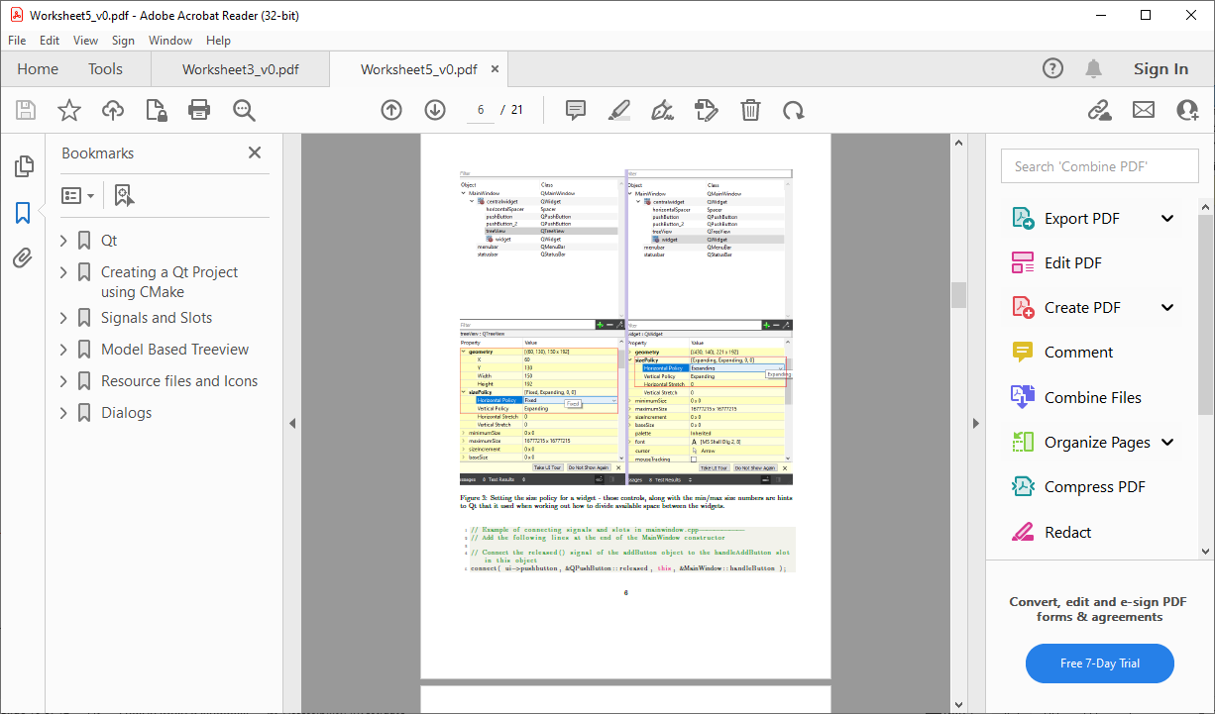
Individual Worksheets
 |  | Sign-off by end of…
1 | Command Line | -
2 | Git & Github | Tues Week 1
3 | Compilers & Visual Studio | Tues Week 1
4 | CMake | Fri Week 1
5 | Documentation and Installers | Fri Week 1
6 | Qt for GUIs | Tues Week 2
7 | VTK for 3D Graphics | Fri Week 2
You need to complete worksheets individually over first two project weeks.
Sign-off in labs by end of Tues/Fri
See marksheets for sign-off criteria
These are “training”:
Exercises demonstrating how to use tools/libraries
At end of worksheet 7, you will each have an application that is close to what is needed for group submission
Copy across to team repository, continue as a group
You will need to write code for these, this code will be uploaded to Github.
You also need to make a submission via Moodle.
Process for this covered next week.
PDFs available on Moodle

Slide 10
Assessment
This is a software development project, so almost all assessment is of:
Code your write
Software performance
Have tried to avoid presentations, reports, or other things not directly related to software development
Code: assessment points are:
Individual worksheets: Sign-off in labs on Tues & Fri of weeks 1 and 2 (David Dewar for signoff)
Group software: Tuesday after last project week (Monday is bank holiday)
Submit installer to Moodle dropbox
I will mark your code directly from but you will still need to submit the ID of a specific Github commit (save point) to Moodle to satisfy University guidelines.
Group demonstration of software and individual viva to test understanding in June
Marking rubrics now on Moodle

Slide 11
Tuesday Week 1 (20%)
WS2 - Repository setup
WS2 - Expected files present
WS2 - Evidence of branching
Friday Week 1 (20%)
WS3 - Static build works
WS3 - Dynamic build works
WS3 - Static release with correct directory struct (bin, lib, etc)
WS3 - Dynamic release with correct directory struct (bin, lib, etc)
WS4 - Static build works
WS4 - Dynamic build works
WS4 - Static release with correct directory struct (bin, lib, etc)
WS4 - Dynamic release with correct directory struct (bin, lib, etc)
WS5 - Documentation can be created with CMake & Doxygen
WS5 - Github pages documentation
WS5 - Installer can be created with CMake & NSIS
Tuesday Week 2 (30%)
WS6 - Tree view working
WS6 - Can edit item name, colour, visible using the dialog
WS6 - Buttons & status bar working
WS6 - Context menu launches dialog
WS6 - Open File Dialog, can be used to change item name
WS6 - Tracked on Github with appropriate number of commits
Friday Week 2 (30%)
WS7 - VTK rendering in Qt application
WS7 - Can render any single part of STL model in application
WS7 - Can add multiple parts to tree and render all
WS7 - Intuitive "Add" behaviour - add new item to child of currently selected item
WS7 - Code stability, does it crash during demo
WS7 - Tracked on Github with appropriate number of commits
Individual worksheets

Slide 12
Group Software & Demo Marks

Slide 13
Approximate / Target Timeline
 |  | Sign-off by end of…
1 | Command Line | -
2 | Git & Github | Tues Week 1
3 | Compilers & Visual Studio | Tues Week 1
4 | CMake | Fri Week 1
5 | Documentation and Installers | Fri Week 1
6 | Qt for GUIs | Tues Week 2
7 | VTK for 3D Graphics | Fri Week 2
Week 1 | M | T | W | T | F
Individual
Group
WS1&2
WS3&4
WS5
WS6
Play with VR System & Demo
Week 2 | M | T | W | T | F
Individual
Group
WS6
WS7
Group work - GUI
Week 3 | M | T | W | T | F
Individual
Group
Group Work - VR

Slide 14
Lectures
1 – 27/01/25 – Introduction to module and topic
Introduction
Assessment
Lab work & equipment
Background to graphics & VR
2 – 03/02/25 – Software development tools
Compiling, linking & building software
Software libraries
Visual Studio
Build systems, Cmake
Git and Github
Code documentation
Installers
3 – 24/02/25 – GUIs and VR
GUIs using Qt
3D Graphics with VTK
VR applications with VTK and OpenVR
Multiple user interfaces and the use of threads
Review group assessment criteria
Before project week 2
Before project week 1

Slide 15
Labs & Groups

Slide 16
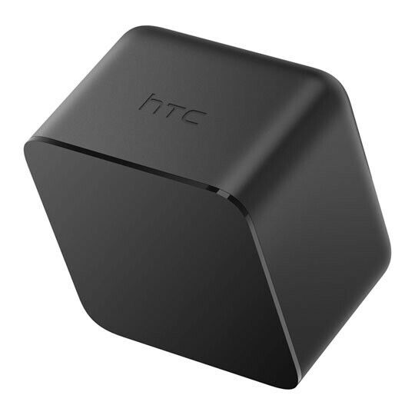
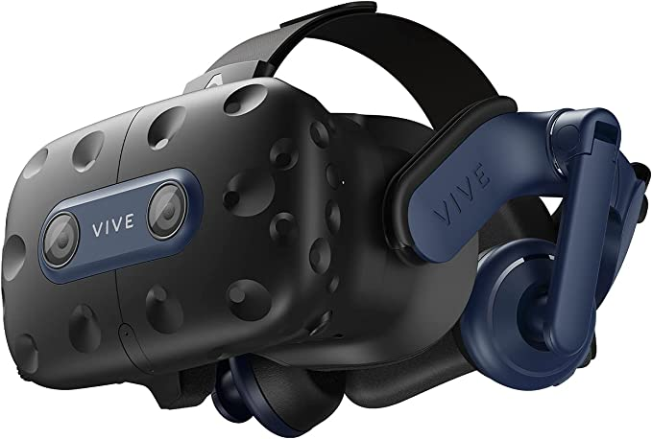
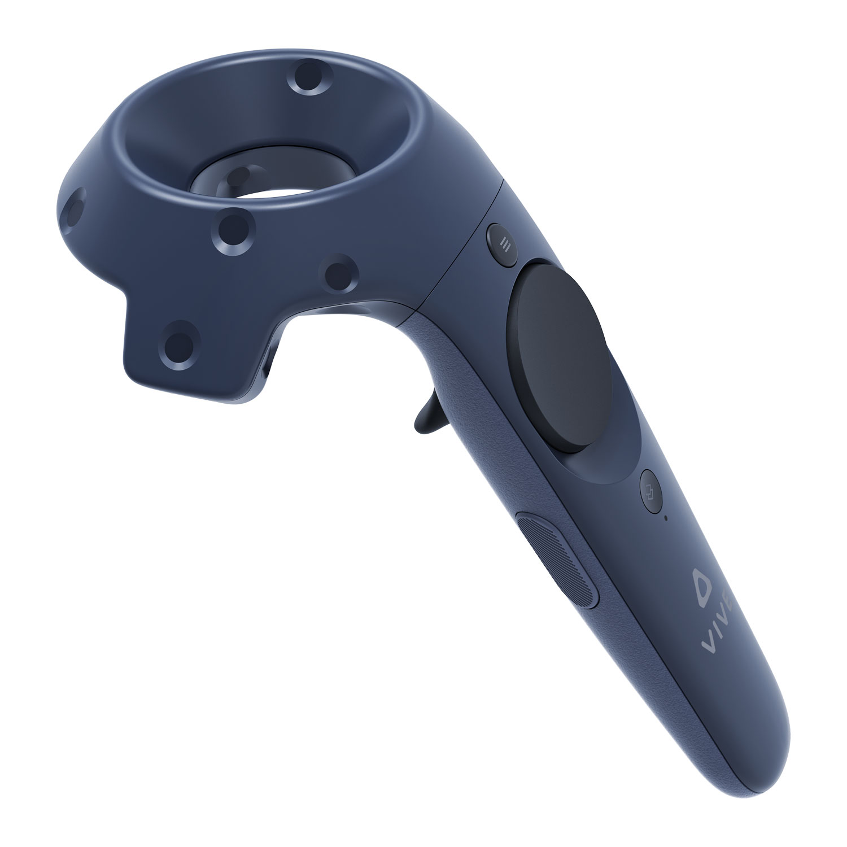
VR Hardware

Slide 17
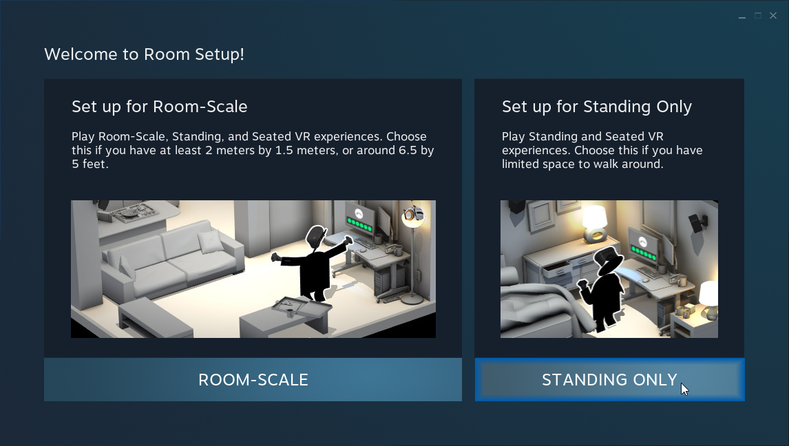
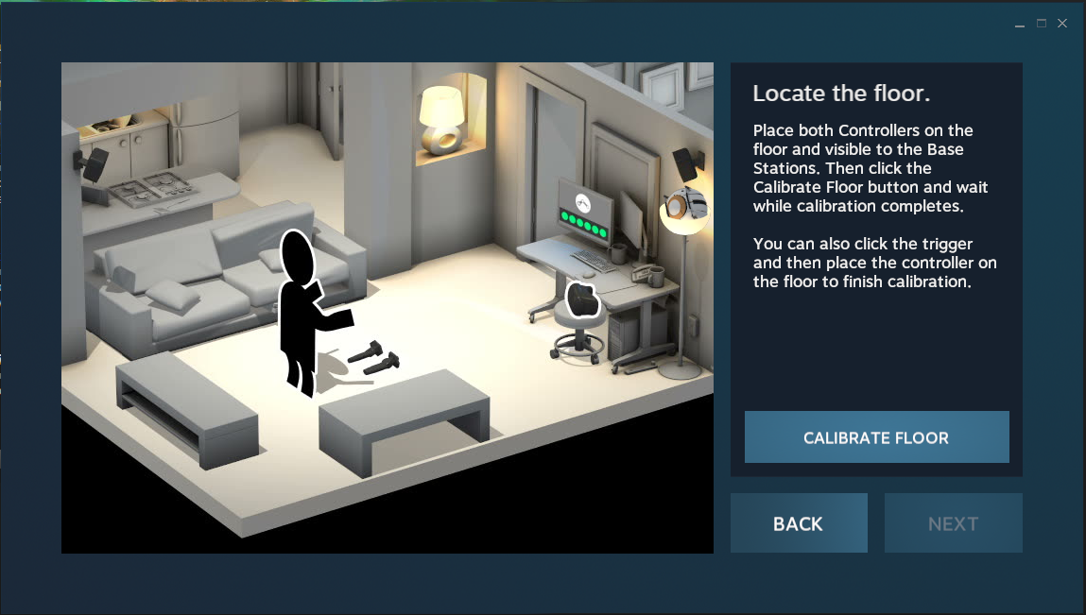
Calibration
Lighthouses can be positioned anywhere, system needs to know how to relate room to lighthouse position
Where is floor, which was is up, etc.
Initial calibration process
Standing
VR doesn’t allow you to walk around (walking around has no effect on virtual position)
Room-scale
Walking around in reality = walking around in VR
For initial testing – use standing, don’t walk around!
For room-scale:
Only use this later, if/when needed
You need to clear a safe area, this is defined in VR.
Must have someone else watching to warn of hazards – will be easy to walk into something/someone or trip over something
System will guide you through calibration process – likely to need to do it at various points (if something changes, system will tell you to recalibrate)

Slide 18
1
5
9
13
17
21
25
29
2
6
10
14
18
22
26
30
3
7
11
15
19
23
27
31
4
8
12
16
20
24
28
32

Slide 19
Groups
Self-select groups of 3
Same selection system as electronics project
Will make system live later today
Deadline for selection Wednesday 5th Feb
Email me if you have problem finding a group or problems with the selection system

